Slide 1
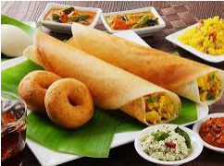
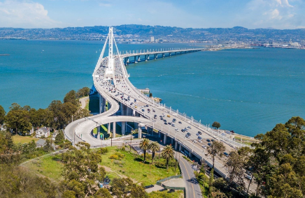
IBM Data Science Professional Certificate Course No.9: Applied Data Science Capstone (The Battle of Neighborhoods)
Best Boroughs to Open an Indian Restaurant in San Francisco Bay Area
By Narahari Marneni
Feb 2021

Slide 2

Objective:
The main objective of the project is to find best boroughs in the San Francisco Bay Area to start a new Indian restaurant business.

Slide 3
Find borough where there are a lot of eateries in the Bay area. Then these boroughs are used as “Center of Attraction” for dining with different food varieties.
Avoid boroughs with existing Indian restaurants;
Select clusters that are similar to boroughs where Indian restaurants are located.
Analytic Approach:

Slide 4
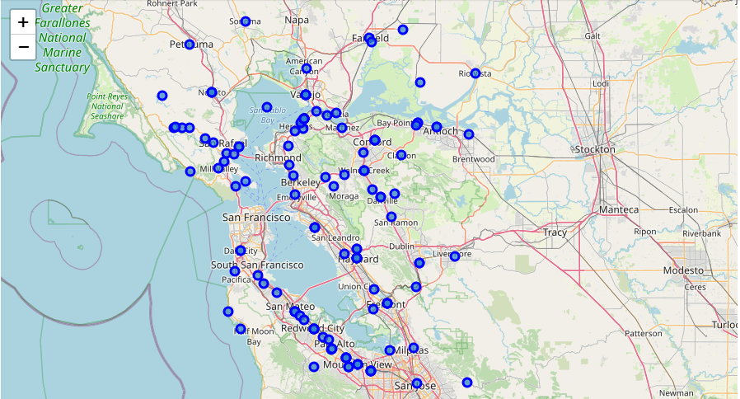
San Francisco Bay Area Boroughs
9 Counties
186 ZIP Codes
97 Boroughs
Multicultural
Tourism attractions

Slide 5



Data sources
https://foursquare.com/
https://datasf.org/opendata/
The San Francisco Bay Area ZIP codes and PO_NAME are downloaded from DataSF open data website.
https://data.sfgov.org/api/views/f9wk-m4qb/rows.csv?accessType=DOWNLOAD
Dataframe is generated with ZIP codes and PO_NAME by renaming PO_NAME to ‘Borough’.
The geographical coordinates are retrieved for each borough using geocoder.
Foursquare AIP service is used to explore venues for each borough within 1000 m radius.

Slide 6
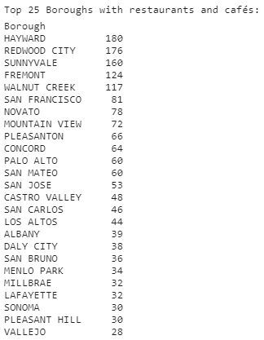
San Francisco Bay Area
Boroughs vs restaurants, cafes, pubs, bars, cuisines
Top 25 borough with restaurants, cafes, pubs, bars, cuisines in the Bay area.

Slide 7
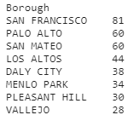
Boroughs with No Indian restaurants
There are 52 well-known Indian restaurants in the Bay area boroughs within 1000 m radius from geographical coordinates.
There are 8 boroughs with no Indian restaurants out of top 25 boroughs with restaurants, cafes, bars, pubs, cuisines in the Bay area.

Slide 8
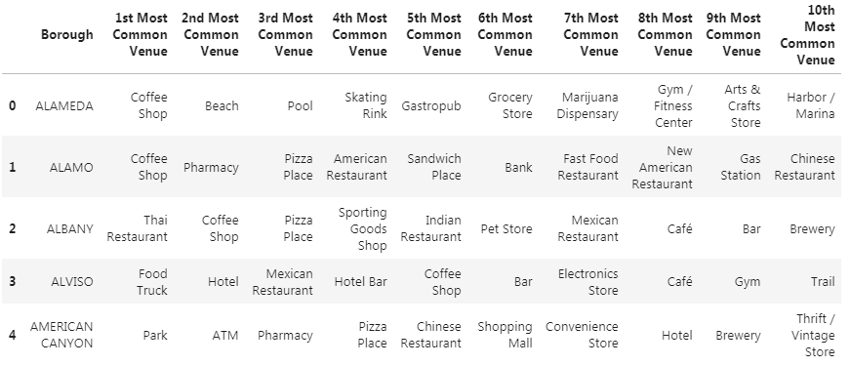
Top 10 venues for each borough
There are 353 unique venue categories.

Slide 9
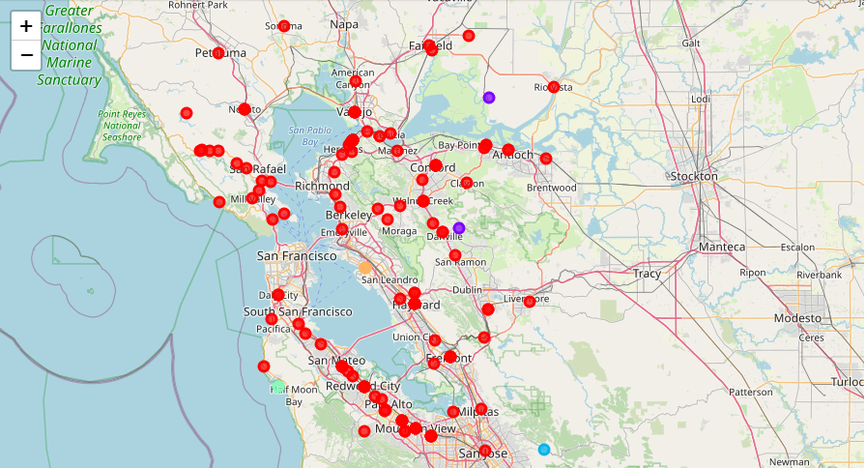
K-means clustering: similar boroughs

Slide 10
Results
DALY CITY, MENLO PARK and PLEASANT HILL are the best boroughs for a new Indian restaurant business in the San Francisco Bay Area.
DALY CITY, MENLO PARK and PLEASANT HILL boroughs are similar to boroughs where existing Indian restaurants are located.

Slide 11


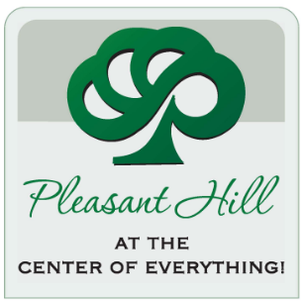
Conclusions
The best boroughs to open an Indian restaurant in the Bay area are:
DALY CITY
MENLO PARK
PLEASANT HILL

Slide 12

Notes:
Thank you all for listening. Now I would like to take any questions from you.

